Slide 1
Welcome to Year 4
Dunlop Class: Blaithin & Clara
Jones Class: Kamilah & Roz
Lovelace Class: Theo
Buki, Isabelle, Adele, Tashnim, Nino

Slide 2
Welcome to Year 4
We will discuss:
Curriculum
Homework
PE
Lunches
Communication
Questions

Slide 3
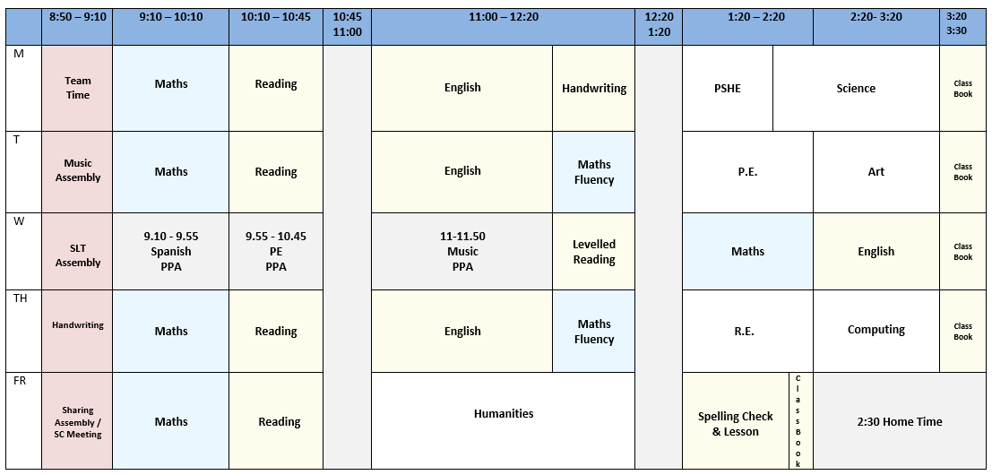
Year 4 Example Timetable

Slide 4
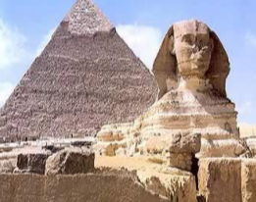
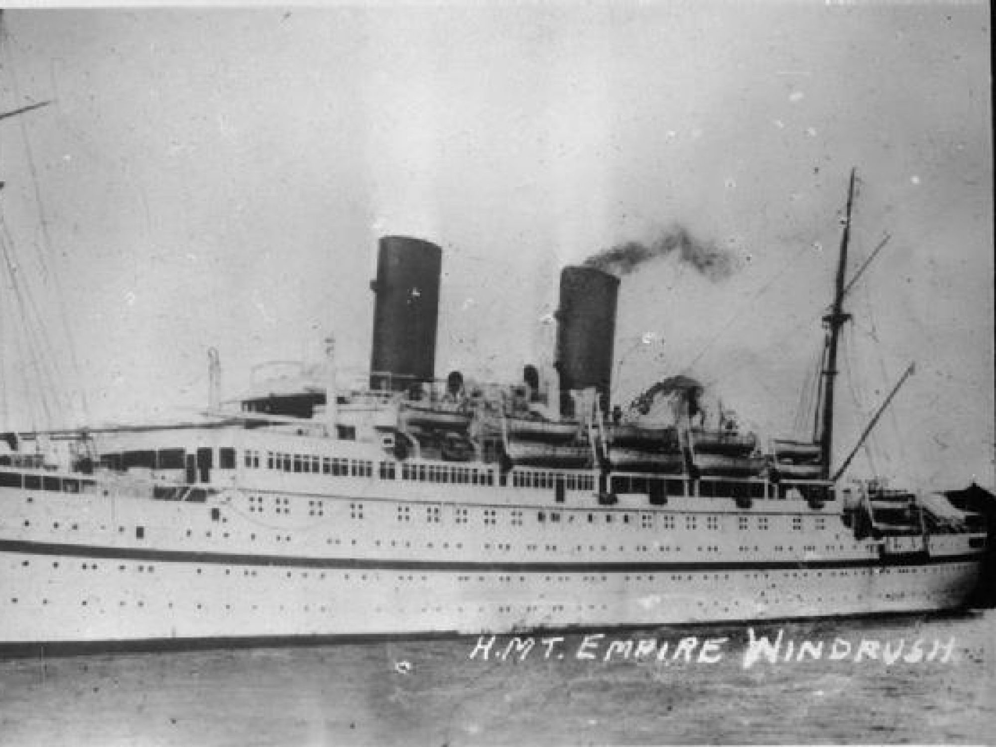
Year 4 Curriculum
Excavating Egypt
The achievements of an early civilisation – depth study
Autumn
A Spanish Fiesta
Study of a region in
a European country. Geographical similarities and differences
Spring
Hackney’s History
A local history study
Summer
Notes:
All of our English learning is taught in the context of our history/geography topics. E.g. newspaper writing about the outbreak of war, ration recipe writing etc.

Slide 5
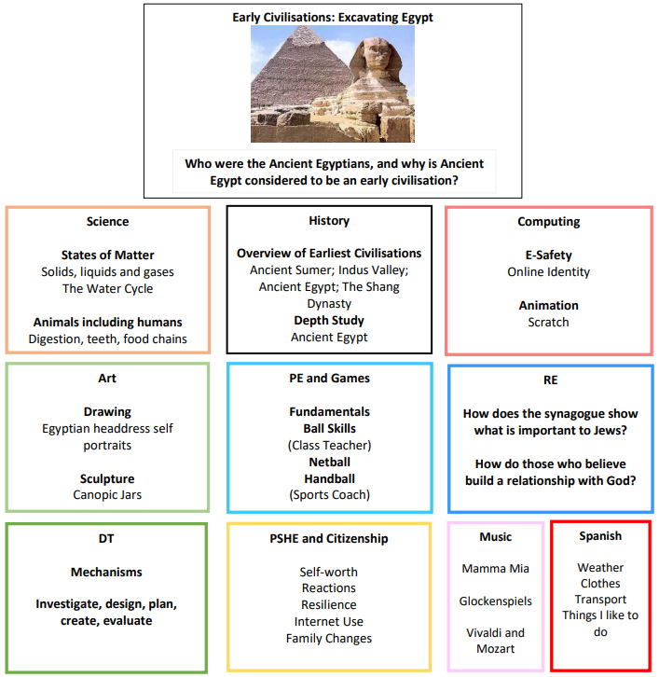
Autumn Term
Notes:
This information was sent out via email last week

Slide 6
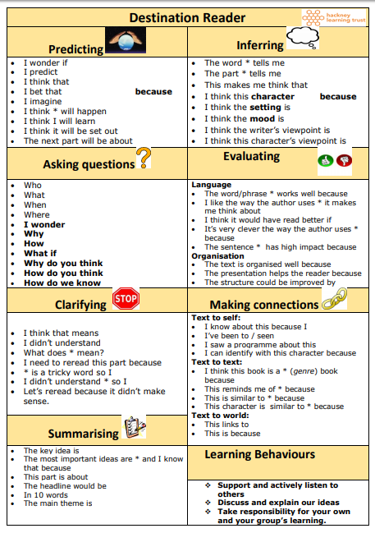
English
Reading, Writing & SPAG
Notes:
In Y3 children begin Destination Reader - a reading programme designed to develop comprehension through the teaching of 7 key strategies. A small number of children who are not yet fluent may continue reading levelled texts daily. Many of the texts in reading will be linked to the topics.
Spelling – children practice a different spelling pattern each week. Homework words will be linked to this.

Slide 7
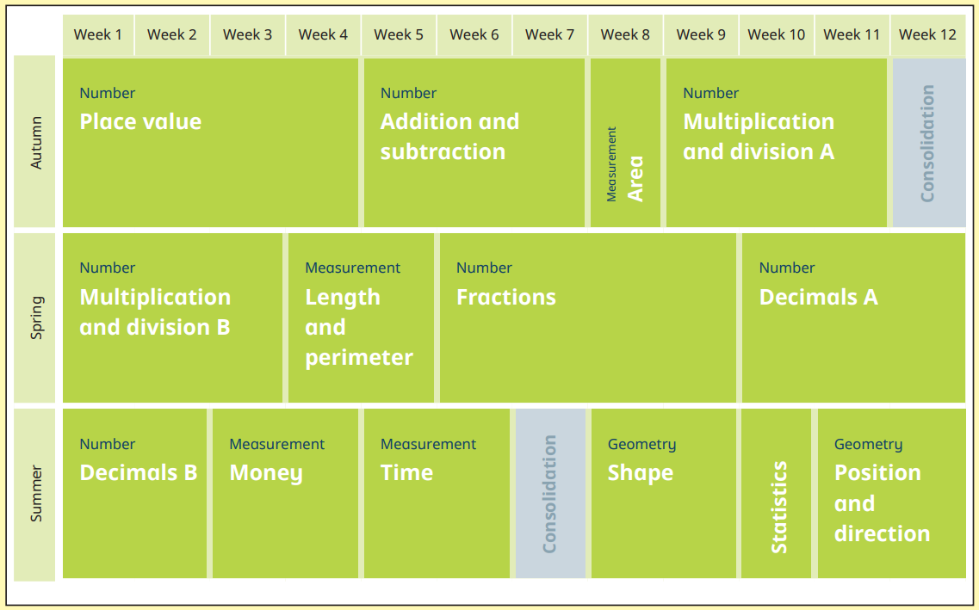
Maths – Year 4 Overview
Notes:
Maths – we follow White Rose Maths.

Slide 8
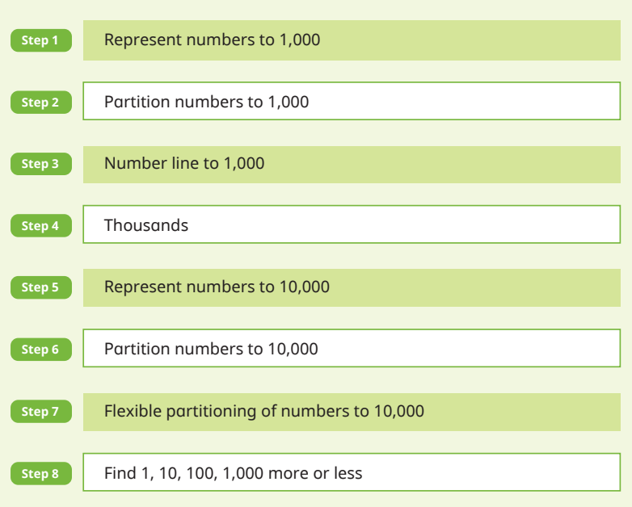
Maths
Each unit is broken down into small steps
Notes:
Here is an example of how each block is broken down into smaller teaching steps. Children are supported to master each step through the use of manipulatives, appropriate questions and activities that get progressively ‘harder’ as children work through. Children who grasp concepts quickly are challenge with reasoning and problem solving questions to deepen understanding.

Slide 9
Year 4 Multiplication Check
Statutory assessment to be taken by pupils at the end of Year 4 (in June).
Compulsory since last year
Online test
Administered in school
25 questions
2 to 12 times tables
6, 7, 8, 9, and 12 times table come up more often
TTRS is excellent practice for this
Notes:
Here is an example of how each block is broken down into smaller teaching steps. Children are supported to master each step through the use of manipulatives, appropriate questions and activities that get progressively ‘harder’ as children work through. Children who grasp concepts quickly are challenge with reasoning and problem solving questions to deepen understanding.

Slide 10
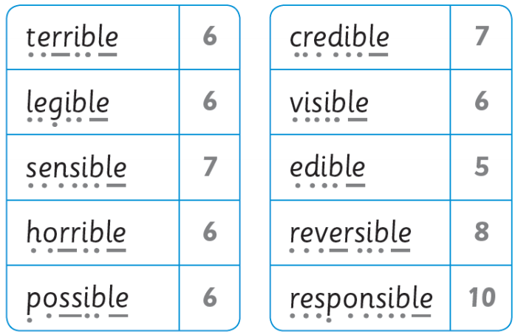
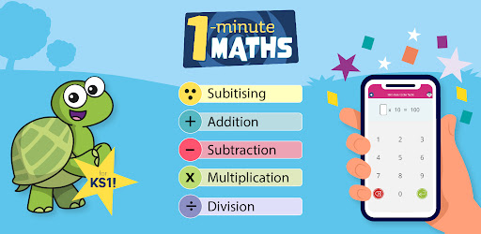
Year 4 Homework
Reading
Spelling
Maths
Book bags must be returned by Tuesday morning
Homework is set on Friday
Notes:
Homework will be sent via Google Classroom starting this Friday – 17th September
Reading – book chosen at child’s level, library book for reading for pleasure, Oxford Owl also has books at different levels
Spelling – selection of words that follow a particular pattern and some commonly misspelt words
Maths Whizz – 20 mins per week
TTRS – 20 mins per week

Slide 11
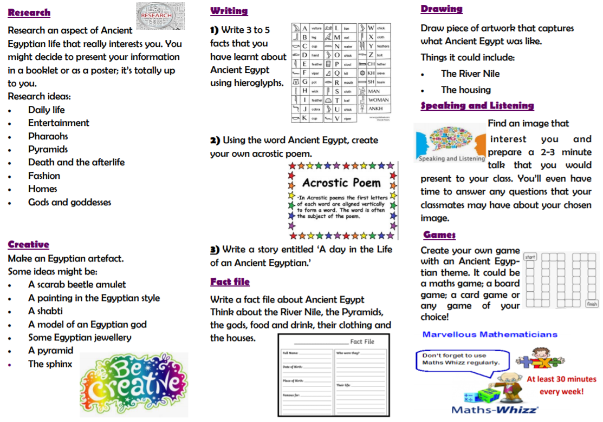
Year 4 Homework
To be completed by the end of each term.
Children will be invited to bring their project into school towards the end of term to share their learning.
Notes:
Termly Projects – open ended.

Slide 12
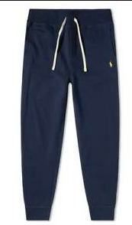
PE Days and PE Kit
Year 4 Classes have PE on:
TUESDAY AND WEDNESDAY
Please ensure that your child comes to school wearing their PE kit on these days.
PLEASE LABEL ALL CLOTHING

Slide 13
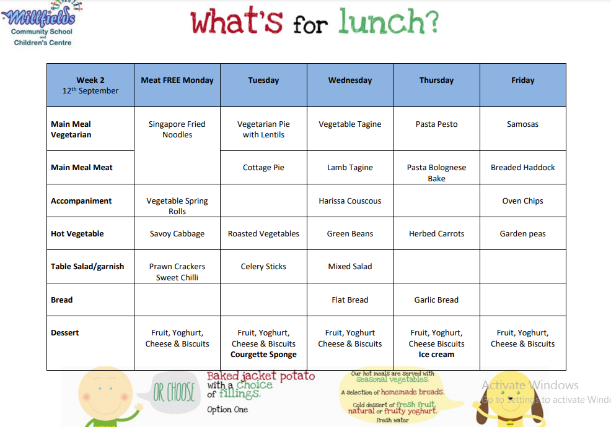
School Lunch
Website: School Lunch
Menu available on website in ‘Parent Information’ section
Please book and pay for school lunch via SCOPAY
Notes:
If your child has any specific dietary needs please let us know ASAP.
In Y3 most pupils are no longer entitled to FSM. If you think your situation means your child may be entitled to FSM please inform the office ASAP and we can assist. Otherwise £2 per day.

Slide 14
Important Dates
What? | When?
Individual Photos | Tuesday 20th September
Dunlop Class Assembly Jones Class Assembly Lovelace Class Assembly | Friday 18th November Friday 21st October Spring Term
Parents Evening | Tuesday 15th November & Wednesday 16th November

Slide 15
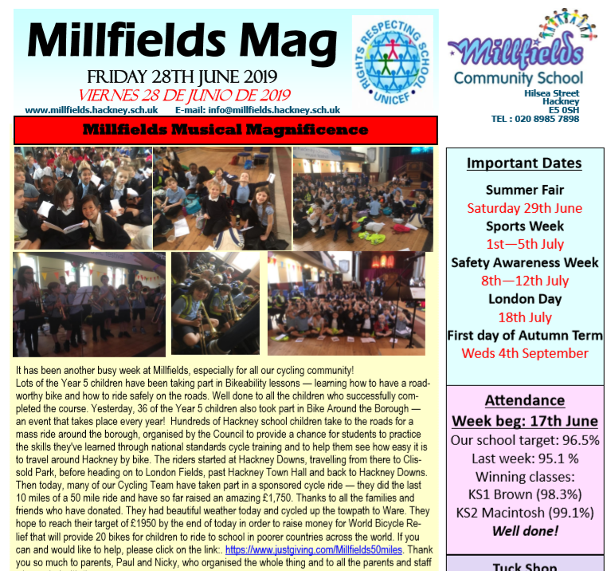
Communication
http://www.millfields.hackney.sch.uk/
Notes:
We use many forms of communication – each useful in their own way. If you are aware that you are not receiving communications from school please contact school office with your details and ask to be added to distribution lists.
Studybugs – reporting absences
MAG – Keep up with life at school and general notices
Texts – More last minute/urgent comms
Email – info from Jane or CT
Google Classroom – Homework and class linked comms
Website – lots of information about life at school

Slide 16
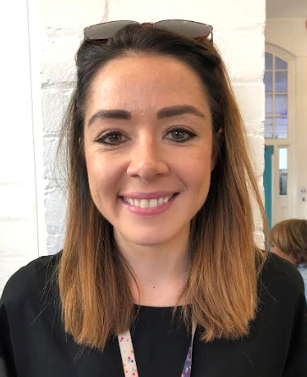
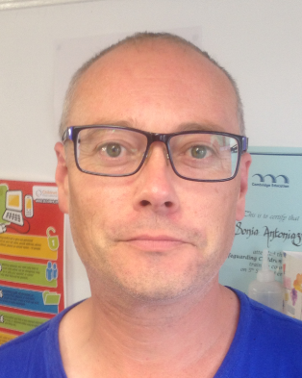
eruane@millfields.hackney.sch.uk
Assistant Head/Phase Lead for Lower Key Stage 2
kfry@millfields.hackney.sch.uk
SENCO - Special educational needs coordinator
cgreen@millfields.hackney.sch.uk
Senior Admin Officer - Attendance/Admissions
iudeaja@millfields.hackney.sch.uk
Extended School Manager/Clubs
Notes:
Please see contact details of individuals here

Slide 17
Questions

